Slide 1
Plotting coordinates generated from a rule using technology
Plotting coordinates

Slide 2
how to use Oak lessons

Slide 3
I can use technology to quickly represent a set of coordinates graphically.

Slide 4

Plotting coordinates generated from a rule using technology
Plotting coordinates in Desmos
Identifying coordinates that do not follow a rule
Creating shapes in Desmos

Slide 5
Plotting coordinates in Desmos
Graphing software can be used to plot coordinates.
Using graphing software can make it easier to spot patterns.
It can also help us see when coordinates do not follow a pattern or spot a mistake.

Slide 6
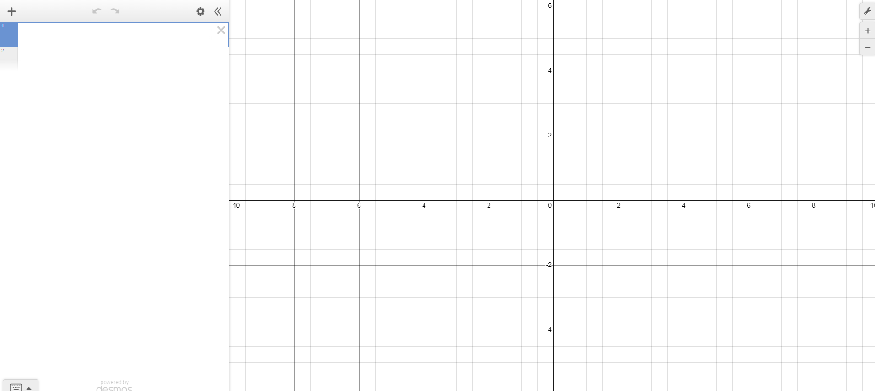
Plotting coordinates in Desmos
To get started:
Open up a web browser and go to desmos.com
Find and press the ‘graphing calculator’ button
Your screen should look like this

Slide 7
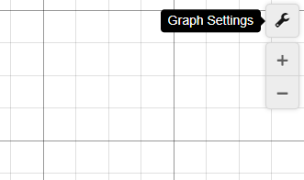
Plotting coordinates in Desmos
We can change the scale on the axes so the numbers increase in the required increments.
To make the values go up in ones:
Click on the ‘graph settings’ menu in the top right of your screen

Slide 8
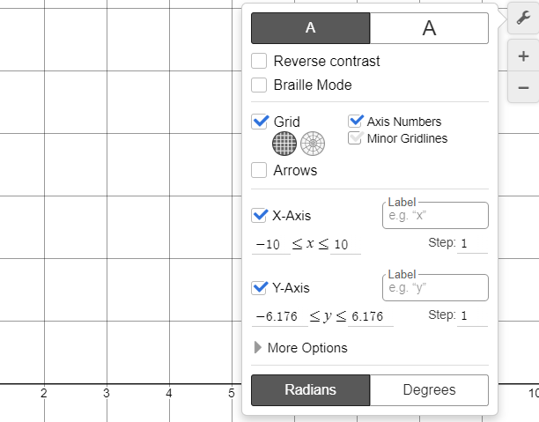
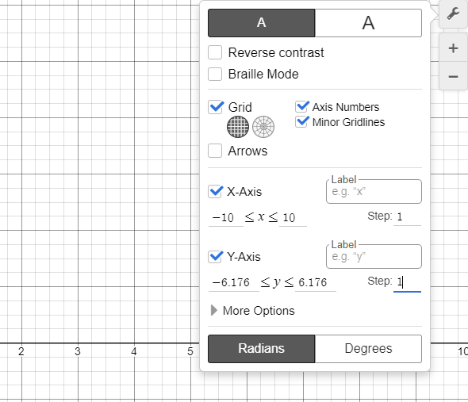
Plotting coordinates in Desmos
We can change the scale on the axes so the numbers increase in the required increments.
To make the values go up in ones:
Click on the ‘graph settings’ menu in the top right of your screen
Change the step to 1
You can unclick the ‘minor gridlines’ if you do not wish to see each step broken down into quarters

Slide 9
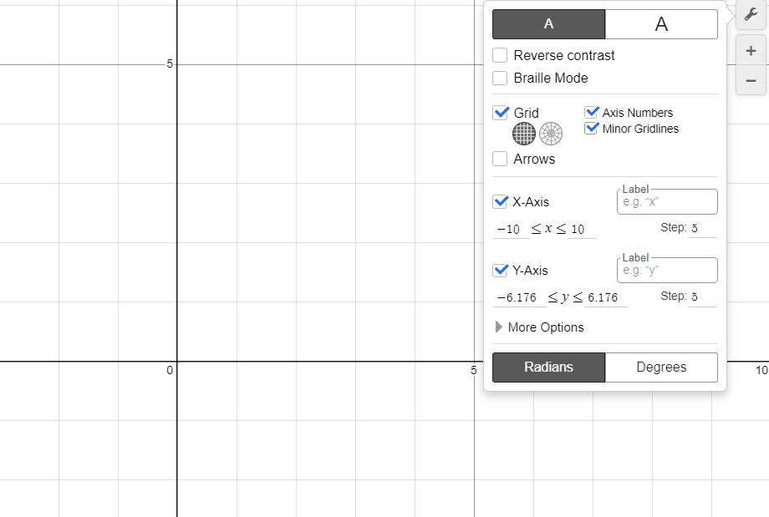
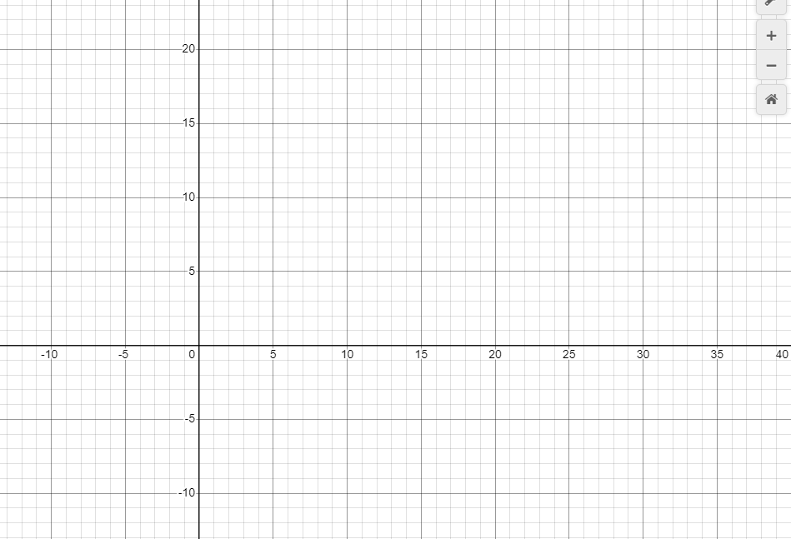
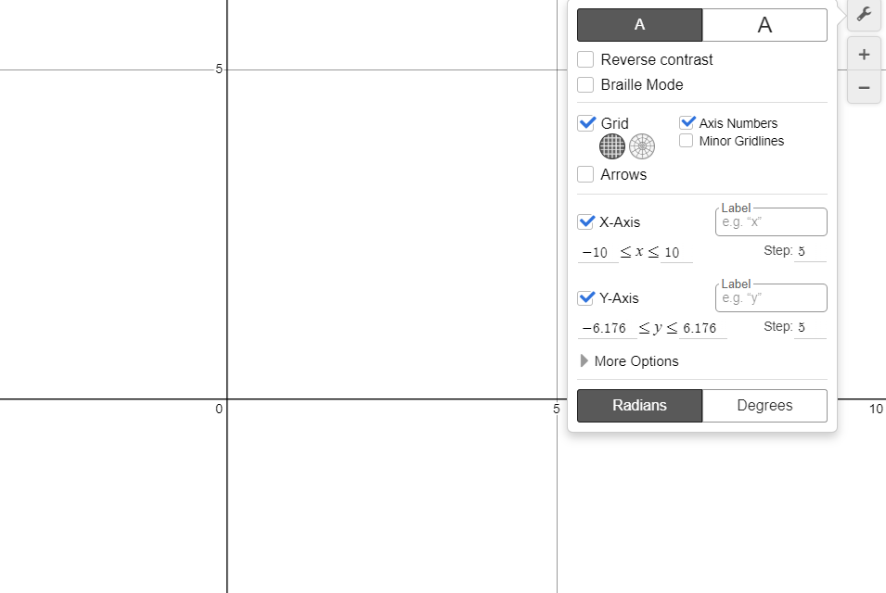
Plotting coordinates in Desmos
Try changing the axes so they increase in 5s.
You may wish to put the minor gridlines back in.
You can zoom in and out by using the buttons below the settings menu.

Slide 10
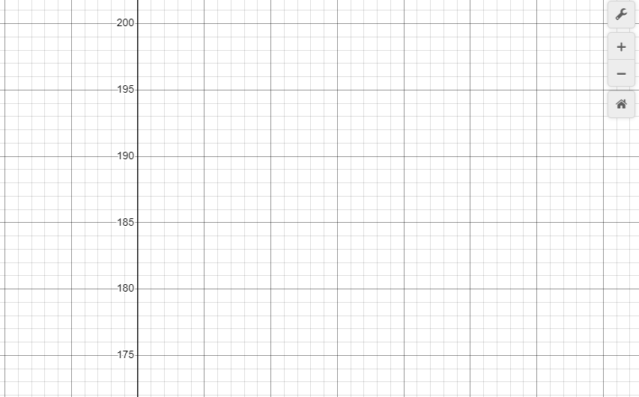
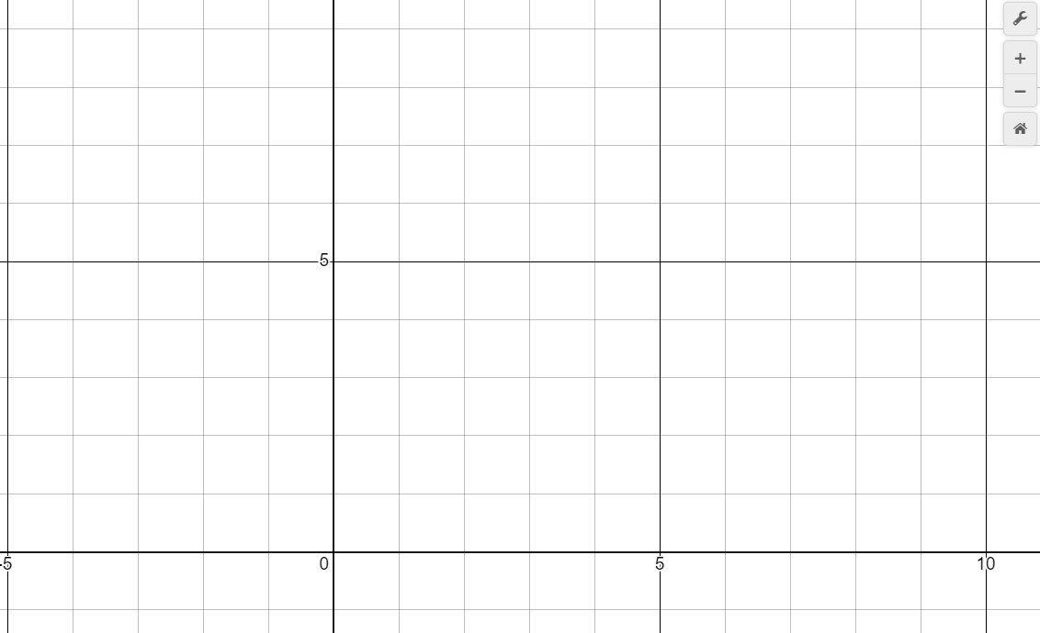
Plotting coordinates in Desmos
You can drag the screen to see different parts of your graph.
Try dragging your screen until you can see 200 on the y axis.
Pressing the ‘default viewport’ button will centre your screen around the origin.

Slide 11
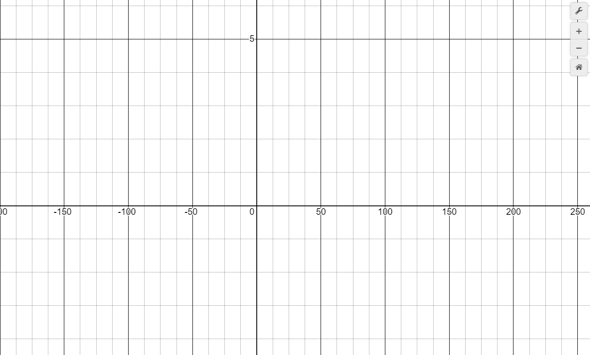
Plotting coordinates in Desmos
You can drag an axis to stretch it.
Press shift then move your cursor onto the required axis
Drag your mouse up or down to scale your y axis in either direction
Drag your mouse left or right to scale your x axis in either direction
Try scaling your x axis to 250 whilst keeping y axis the same.

Slide 12
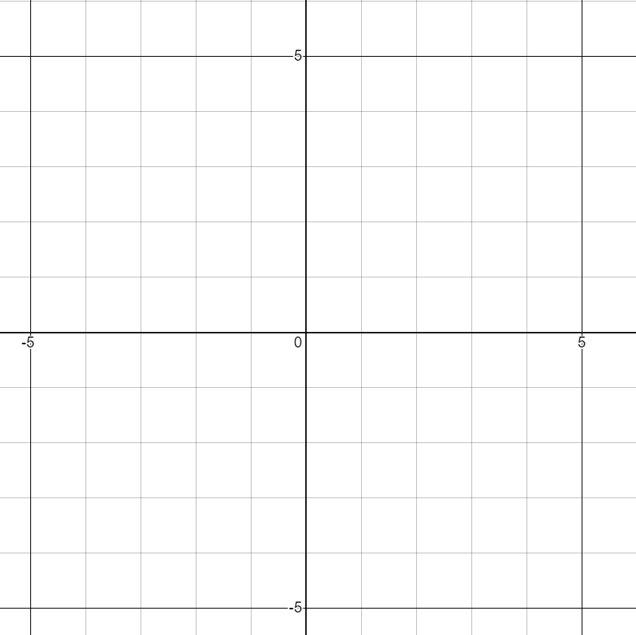
Plotting coordinates in Desmos
Pressing the ‘default viewport’ button will return the axes to the same scale and centre your screen around the origin again

Slide 13

Plotting coordinates in Desmos
The x and the y axis have to increase by the same step.
You cannot change the step on the y axis.
You can change the step on the axes separately to have different steps.

Slide 14
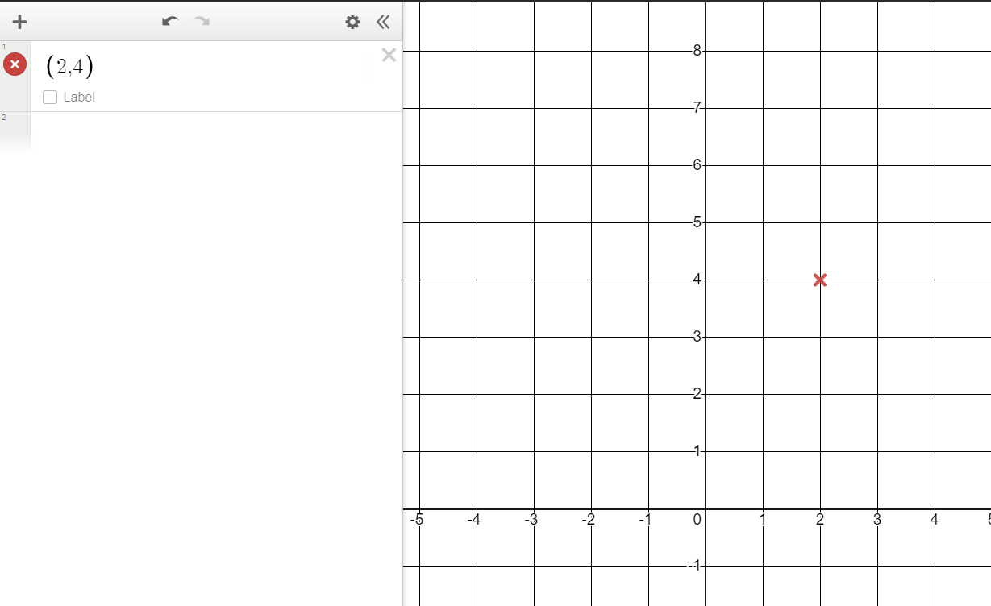
Plotting coordinates in Desmos
You can plot coordinates by typing the coordinate into the left hand menu.
Remember coordinates need brackets and a comma to separate the x and y coordinate e.g. (2,4).
The graphing software will plot this point on your axis.

Slide 15
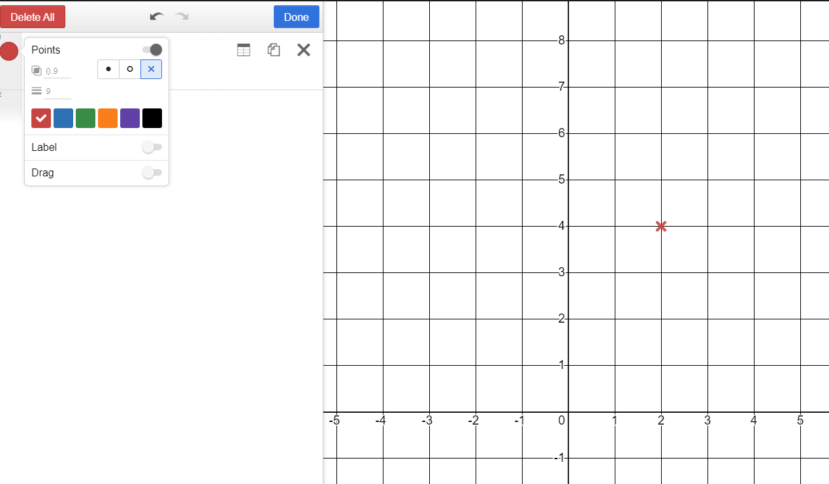
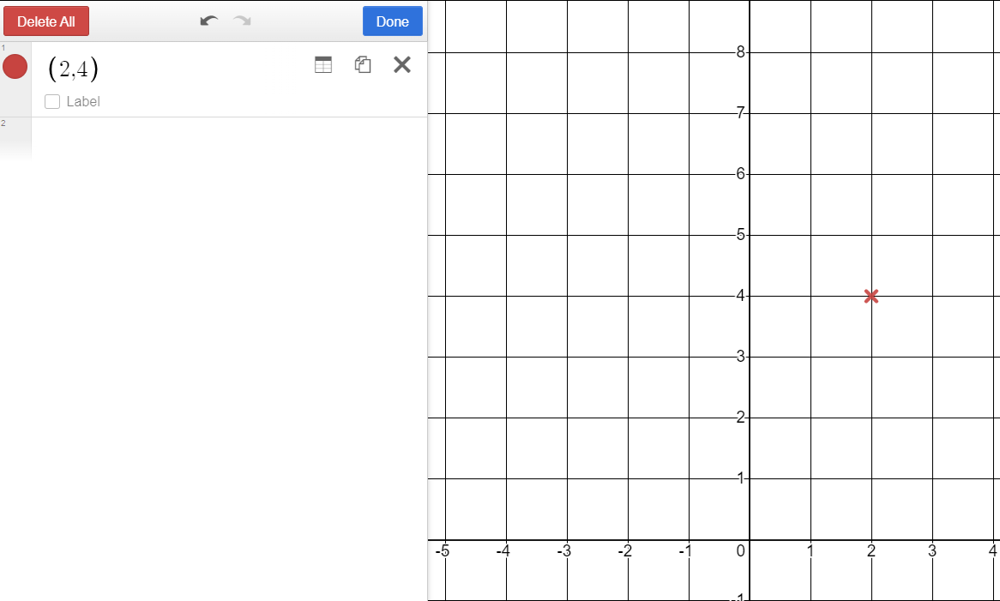
Plotting coordinates in Desmos
You can change the colour and point type by clicking on the ‘edit list’ button.
Click on the ‘edit list’ button
Click on the coloured dot next to the coordinate you want to change
Select the colour or dot type you require

Slide 16
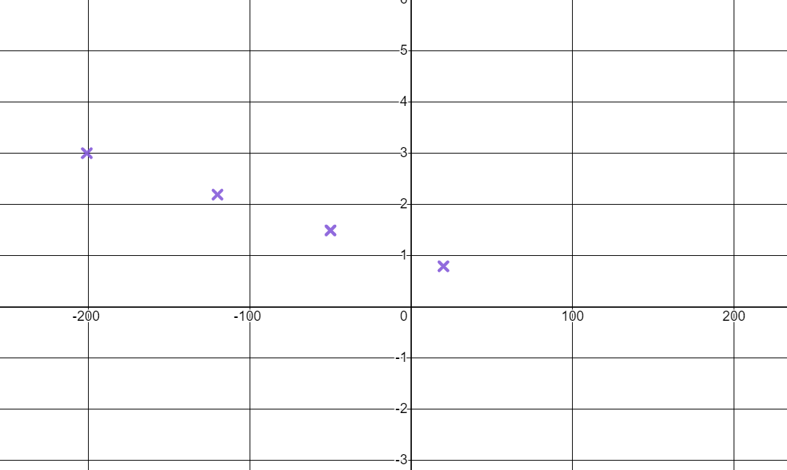
Plotting coordinates in Desmos
Plot these coordinates. (-201,3) (-50,1.49) (-120,2.19) (20,0.79)
Which of the below best describes the pattern they form?
(you may need to change your x axis scale)
A quadrilateral
A horizontal line
A diagonal line
No pattern

Slide 17

Plotting coordinates in Desmos
On
your
graphing
software
press the
button if visible.
Change the step on your x axis to 3. Change the step on your y axis to 4
What integer values do your axes range from and to?
Move your axis until you can see 28 on the y axis. What is the next value visible below 28?
Press the
button. Describe what this does to your axes.
Plot the coordinates (2,4) and (2,6). Plot a third coordinate so it is in the middle of these coordinates. What coordinate did you plot?

Slide 18
Plotting coordinates in Desmos
On
your
graphing
software
press the
button if visible.
Change the step on your x axis to 3. Change the step on your y axis to 4
What integer values do your axes range from and to?
For most display screens the x axis will range from -9 to 9 and the y axis from -4 to 4
Move your axis until you can see 28 on the y axis. What is the next value visible below 28?
24
Press the
button. Describe what this does to your axes.
It centres the screen around the origin. It also changes the axis so they have the same scale (although the steps are still different)
Plot the coordinates (2,4) and (2,6). Plot a third coordinate so it is in the middle of these coordinates. What coordinate did you plot?
(2,5)

Slide 19
Plotting coordinates generated from a rule using technology
Plotting coordinates in Desmos
Identifying coordinates that do not follow a rule
Creating shapes in Desmos

Slide 20
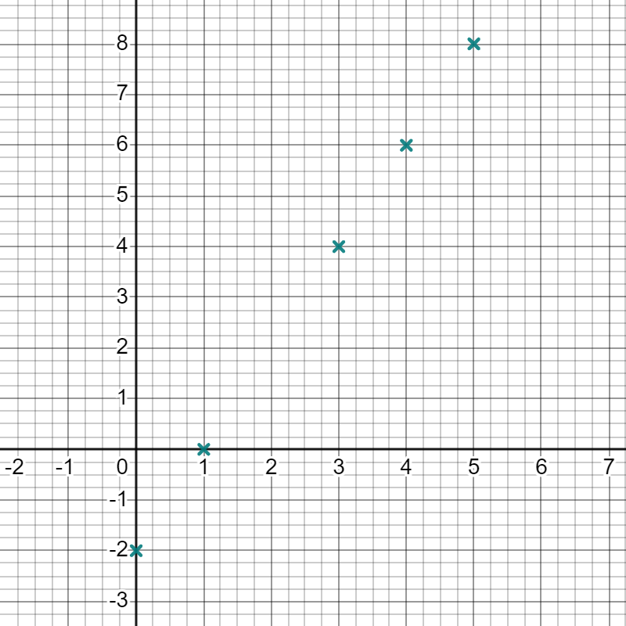
Identifying coordinates that do not follow a rule
Plotting coordinates in Desmos can make it easy to see whether there is a pattern.
Plot the coordinates below, what do you notice?
(5,8) (4,6) (0,-2) (3,4) (1,0)
They all lie on a straight line.
Can you find another coordinate that lies on the same line?
(2,2) There are other options beyond these axes or using non-integer values.

Slide 21
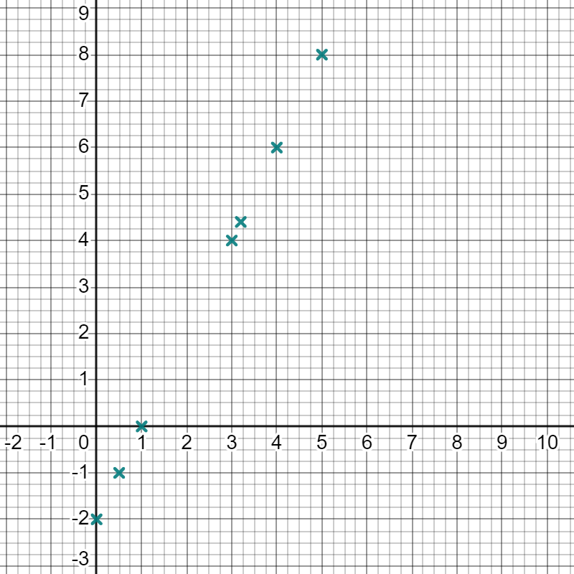
Identifying coordinates that do not follow a rule
Using Desmos can be especially helpful when working with non- integer coordinates.
Add the coordinates (0.5,-1) and (3.2,4.4) to your graph.
Do these coordinates follow the same rule?
How do you know?
Yes, as they sit on the same line.

Slide 22
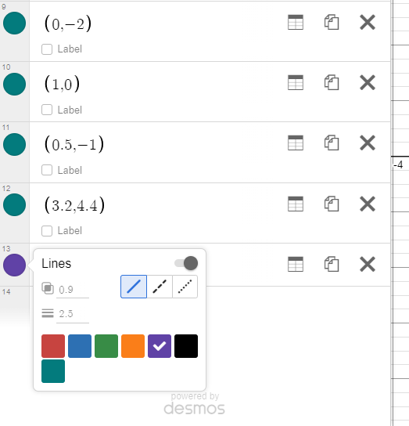
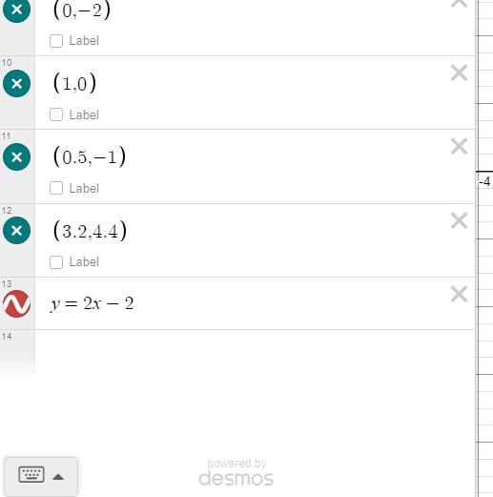

Identifying coordinates that do not follow a rule
If you know the rule linking all the coordinates, you can write the equation into Desmos.
Click on the left-hand menu
Type in the equation that links all
the coordinates
(try
)
The colour and style can be changed in the same way as a coordinate
Does the line go through all your coordinates?

Slide 23
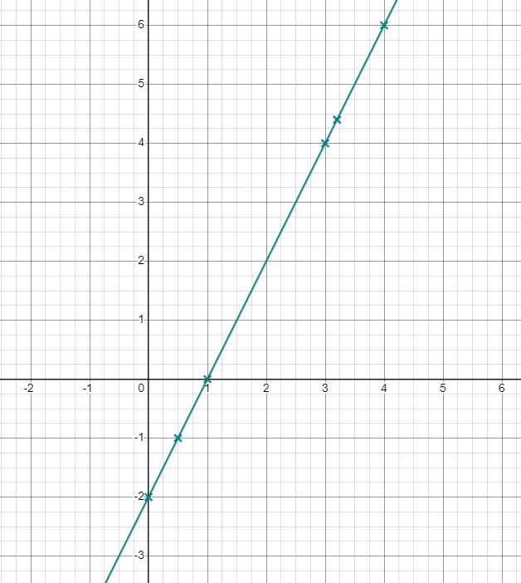
Identifying coordinates that do not follow a rule
Does the line go through all your coordinates?
Yes, so the coordinates must satisfy this rule.
Why do you think Desmos has drawn
a straight line and not just plotted all
the points
?
that fit
the rule
There are an infinite number of points that fit this rule.
Drawing a line shows all the points that follow this rule including decimal values.

Slide 24
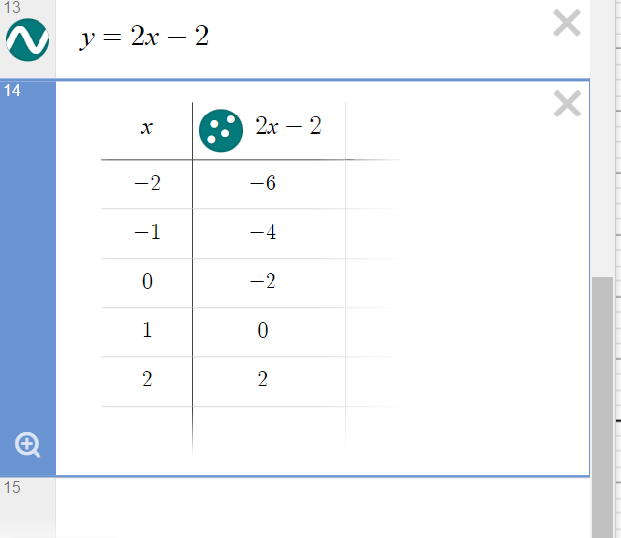
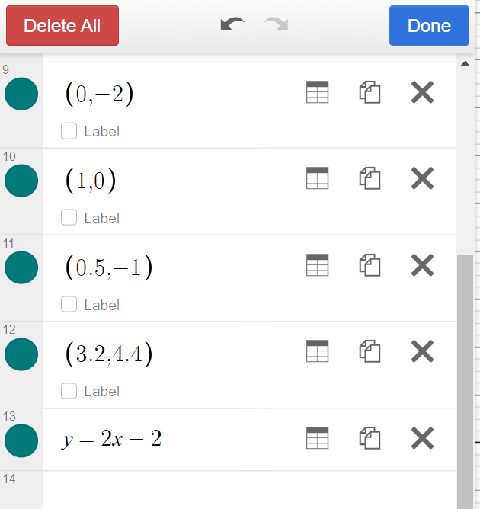
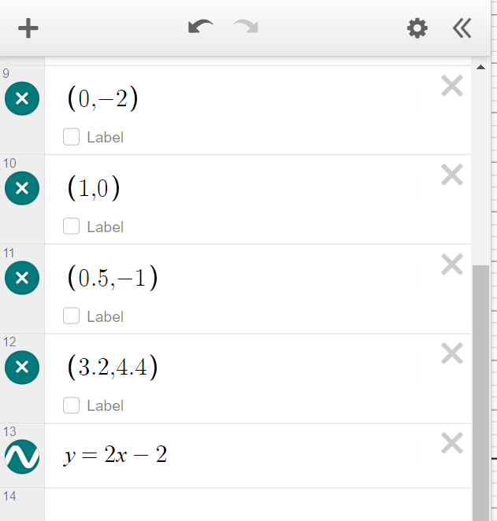
Identifying coordinates that do not follow a rule
You can get Desmos to generate coordinates that follow a rule.
Click on the edit list button
Click on ‘create table’
This will bring up a table with some examples of coordinates that fit the rule
coordinate
coordinate

Slide 25
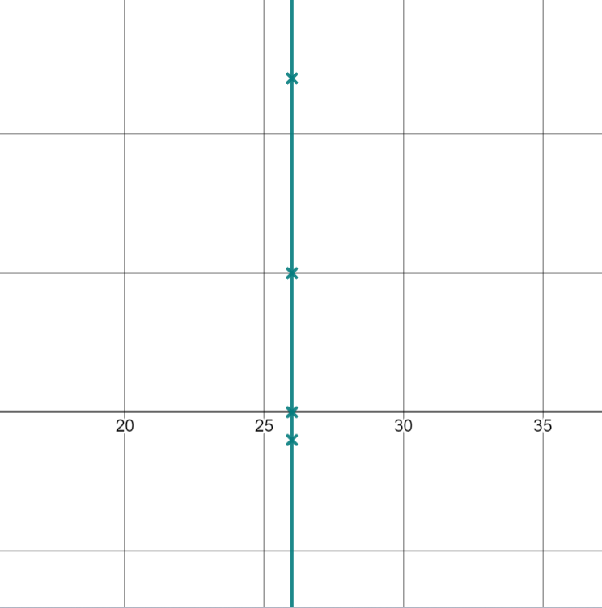
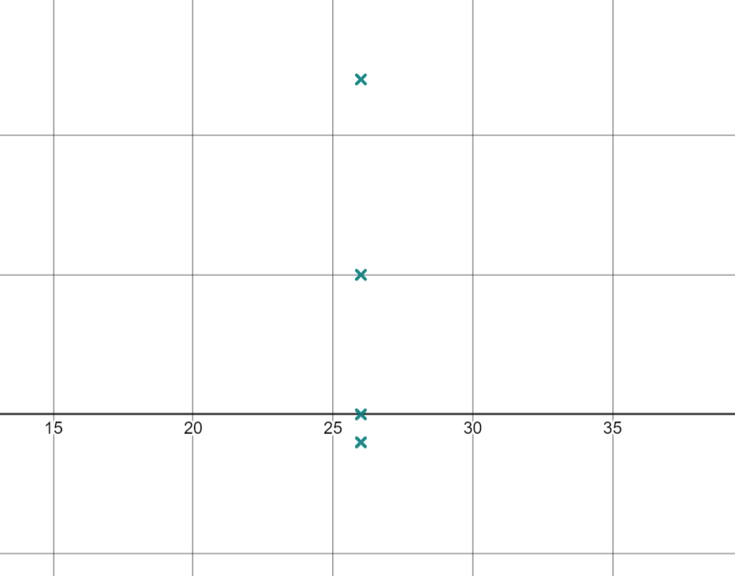

Identifying coordinates that do not follow a rule
Plot the coordinates (26,5) (26,-1) (26, 12) (26,0).
You may need to move your axes to find them.
What do you notice about those points?
They sit on a vertical line
How can we write an equation for this rule?
Type your equation in to check if it’s correct.
If the line goes through the points, it is correct.

Slide 26

Identifying coordinates that do not follow a rule
We can check we have the correct rule by typing the rule and coordinates into Desmos.
Do these coordinates lie on these lines?
(-2,4)
(0,4)
(4,4)
(1,4)
The y coordinate is 4

Slide 27
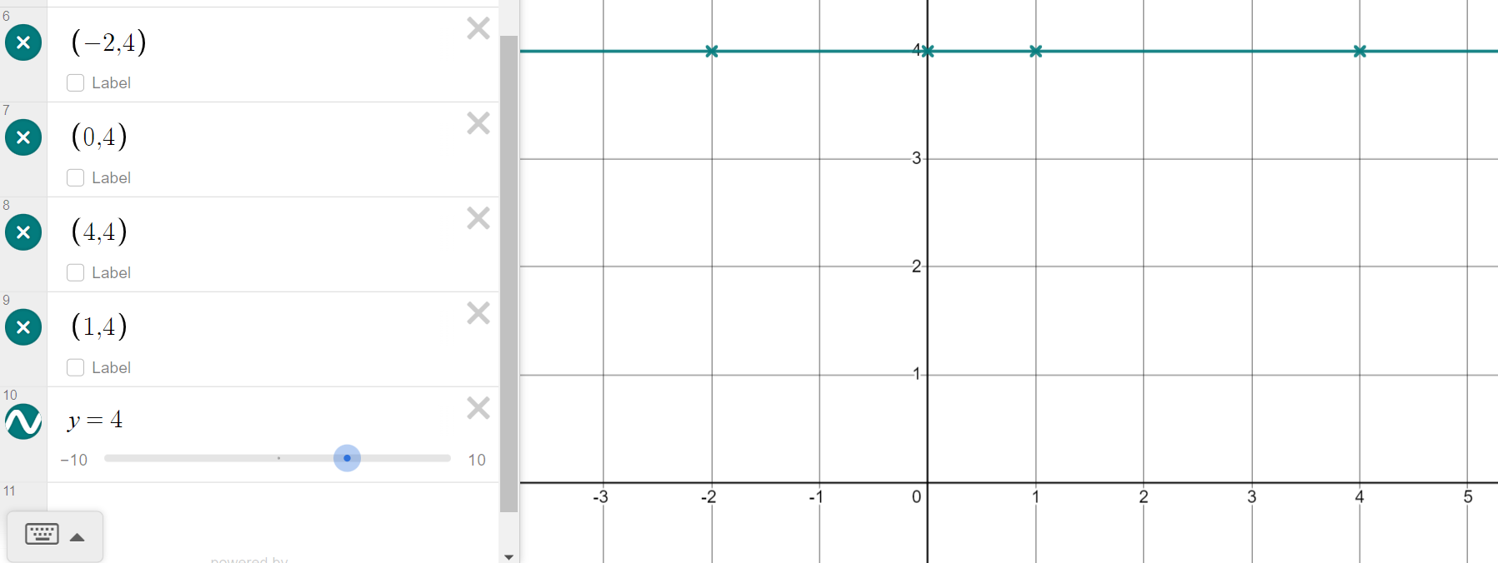
Identifying coordinates that do not follow a rule
We can check we have the correct rule by typing the rule and coordinates into Desmos.
(-2,4) (0,4) (4,4) (1,4)
The line goes through all 4 coordinates so must be correct.

Slide 28
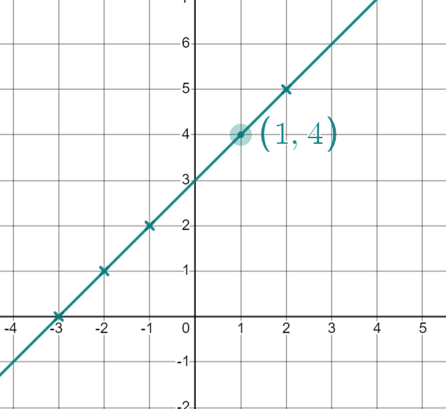
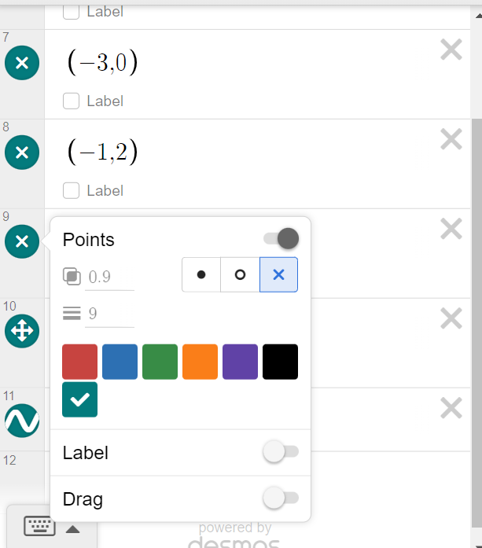
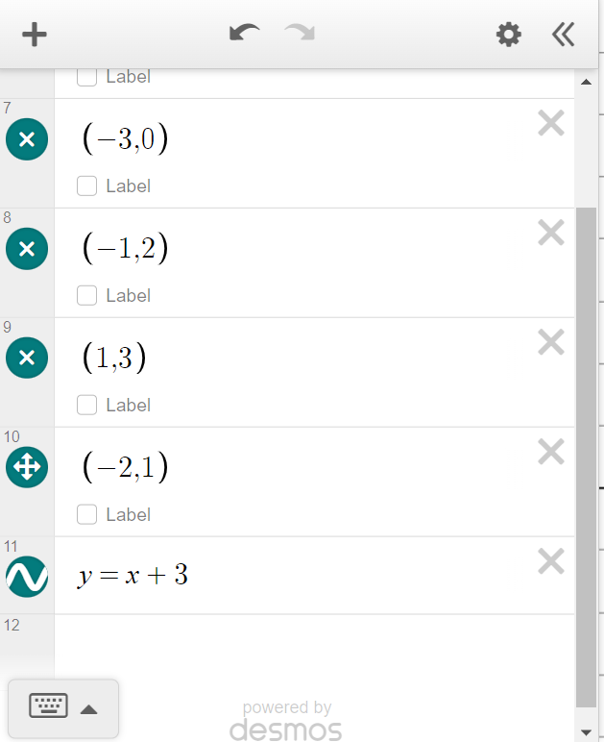
Identifying coordinates that do not follow a rule
You can make any point draggable:
Click on the edit list button
Click on the coloured dot next to the coordinate
Click on the slider next to ‘drag’ to turn drag on
Try doing this for the coordinate (1,3)
Click on the point and drag it until it is on the line and has integer coordinates
What does the coordinate read now?
(1,4)

Slide 29

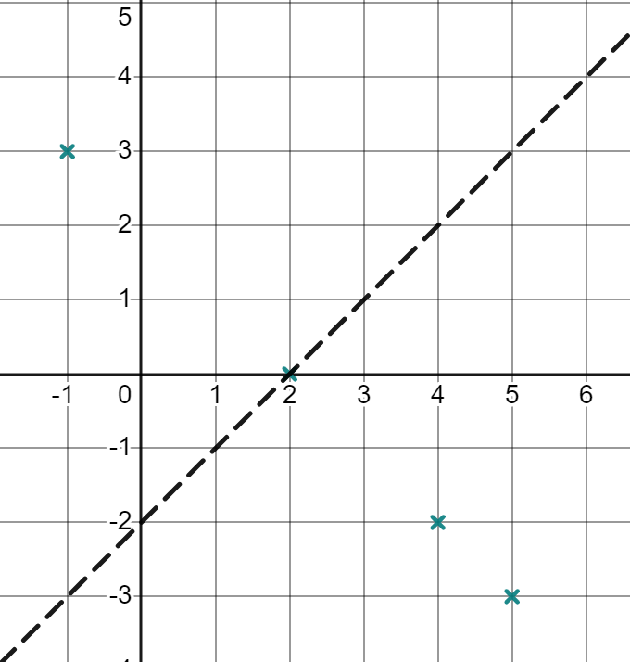
Identifying coordinates that do not follow a rule
Andeep has plotted these four coordinates (5,-3) (2,0) (4,-2) (-1,3)
He thinks
they have
the rule
(shown by the black dashed line).
Do these 4 coordinates follow a rule? How do you know?
Has he written the correct equation for the rule linking these 4 coordinates? How do you know?
Yes because they make a pattern when plotted (they lie on a straight line).
No, because his line does not go through all his points.

Slide 30

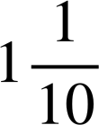
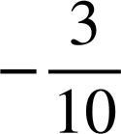
Identifying coordinates that do not follow a rule
Plot each set of coordinates in turn. Identify the coordinate which is the odd one out.
(0,-4) (4,8) (1,-1) (2,6) (-2,-10)
(0,7) (4,4) (10,-2) (-1,9) (2,6)
(8,-1.4) (5,-1.85) (-4,3.2) (12,-0.8) (-9,-3.95)
(11,2.9)
(1, )
(-9,-1.1)
(2, )
(-5, )

Slide 31
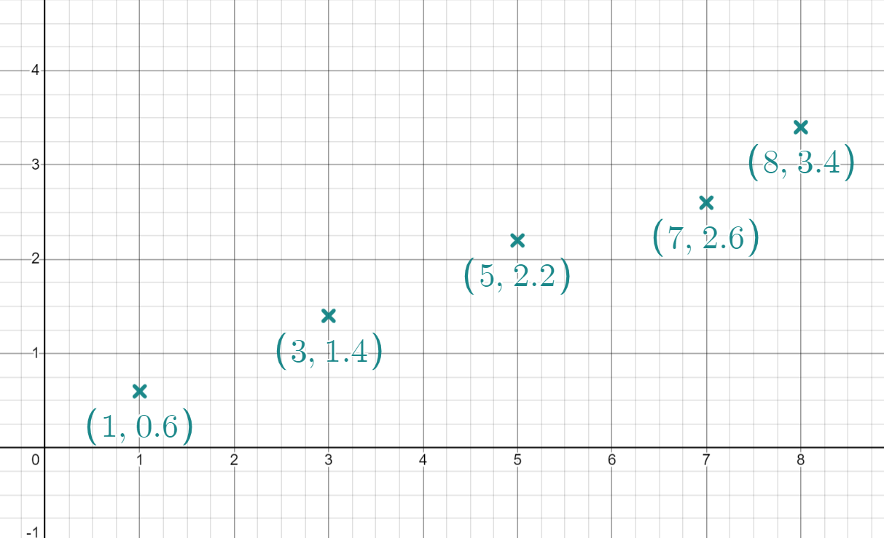
Identifying coordinates that do not follow a rule
Izzy has plotted the coordinates below.
Which one do you think she has plotted incorrectly? How do you know?
b)
Recreate Izzy’s graph.
Make the incorrect coordinate draggable.
Drag the coordinate so it is in line with the rest and on a coordinate where both values are integers.
What coordinate have you now plotted?

Slide 32
Identifying coordinates that do not follow a rule
Plot each set of coordinates in turn. Identify the coordinate which is the odd one out.
(0,-4)
(4,8)
(1,-1)
(2,6)
(-2,-10)
(0,7) (4,4) (10,-2) (-1,9) (2,6)
(8,-1.4)
(5,-1.85)
(-4,3.2)
(12,-0.8)
(-9,-3.95)
(11,2.9)
(1, )
(-9,-1.1)
(2, )
(-5, )

Slide 33
Identifying coordinates that do not follow a rule
Izzy has plotted the coordinates below.
Which one do you think she has plotted incorrectly? How do you know?
(7,2.6) because it doesn’t sit on a straight line with the other 4 points.
b)
Recreate Izzy’s graph
make the incorrect coordinate draggable.
Drag the coordinate so it is in line with the rest and on a coordinate where both values are integers.
What coordinate have you now plotted?
(7,3) or (2,1) There are other possibilities not visible on this graph.

Slide 34
Plotting coordinates generated from a rule using technology
Plotting coordinates in Desmos
Identifying coordinates that don’t follow a rule
Creating shapes in Desmos

Slide 35
Creating shapes in Desmos
We can use Desmos to create mathematical shapes.
Type in these 4 coordinates (-2,-3) (-6,-4) (-7,0) (-3,1)
What shape have you plotted?
square
rectangle
rhombus
parallelogram
kite

Slide 36
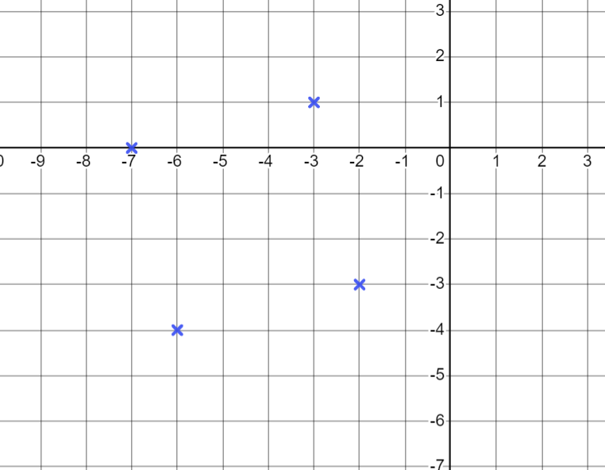
Creating shapes in Desmos
You should have plotted a square.
Ever though it is tilted, the sides meet at right angles and are the same length, so it is a square.
Stretch the scale of your x axis.
Press and hold the shift key
Move your cursor over the x axis
Drag your mouse right

Slide 37
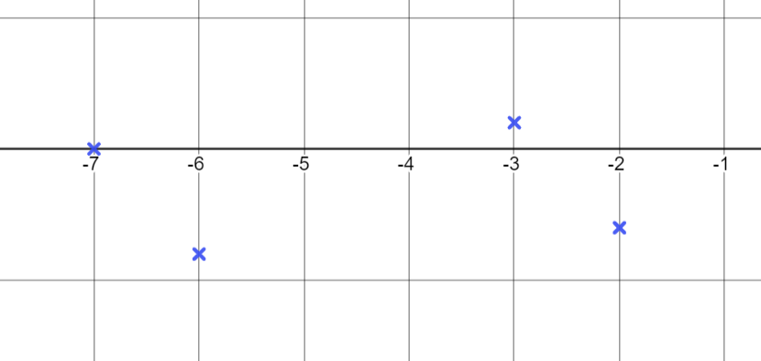
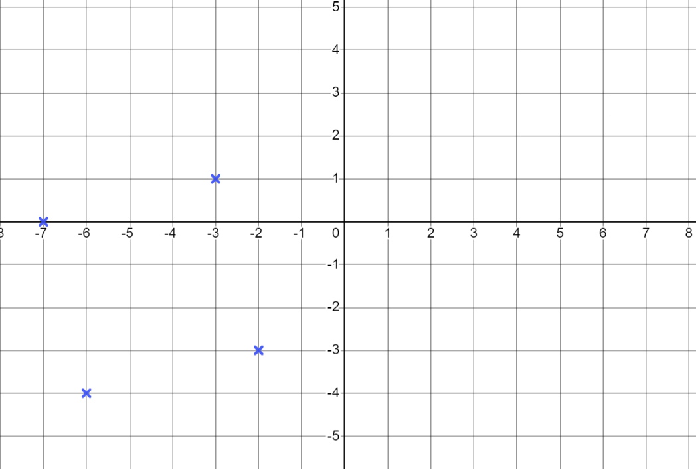
Creating shapes in Desmos
What happens to your square when one of the axes is stretched?
We get a parallelogram because we’ve changed the scale on one axis
Click on the default viewport
button
to bring both axes
back to the same scale.

Slide 38
Creating shapes in Desmos
Changing the scale on one axis will change a shape made out of coordinates.
Changing the scale moves all points to different coordinates.
When the scales are different on the two axes, the distance between the numbers are different in the x and y directions.

Slide 39
Creating shapes in Desmos
1) For each set of coordinates, find the fourth coordinate to make a square.
(0,0) (8,-2) (10,6)
(0,0) (4,5) (-1,9)
(0,0) (7,-3) (3,7)
(2,3) (-1,-4) (4,-2)
(-10,0.5) (-8,1.5) (-9,-1.5)

Slide 40
Creating shapes in Desmos
2) Plot each set of coordinates to determine the type of quadrilateral they make.
square
rectangle
parallelogram
kite
(-12.5,-3) (-12.5, 1.5) (0,-3) (0,1.5)
(-8.2,-20) (1.4,-16.3) (-1.2,-16.3) (-5.6,-20)
(0,9) (3,9) (0,6) (4,5)
(-2,3) (3,3) (2,5) (-1,1)

Slide 41
Creating shapes in Desmos
1) For each set of coordinates, find the fourth coordinate to make a square.
(0,0) (8,-2) (10,6)
(0,0) (4,5) (-1,9)
(0,0) (7,-3) (3,7)
(2,3) (-1,-4) (4,-2)
(-10,0.5) (-8,1.5) (-9,-1.5)
(2,8)
(-5,4)
(10,4)
(-3,1)
(-7,-0.5)

Slide 42
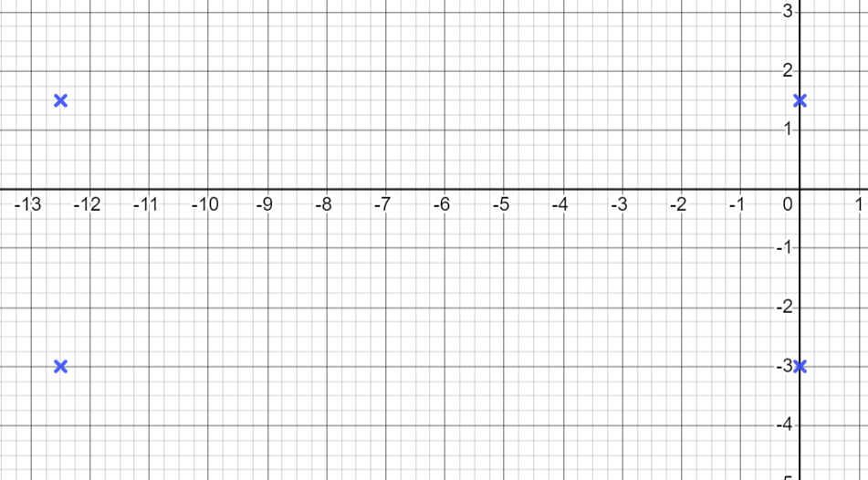
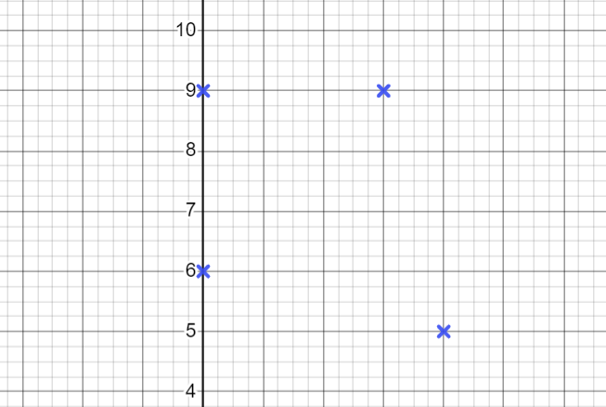
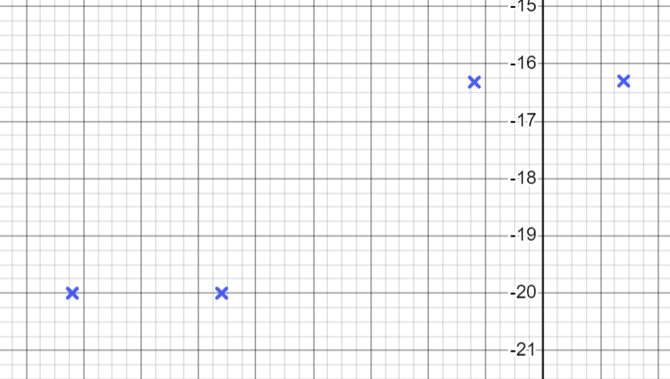
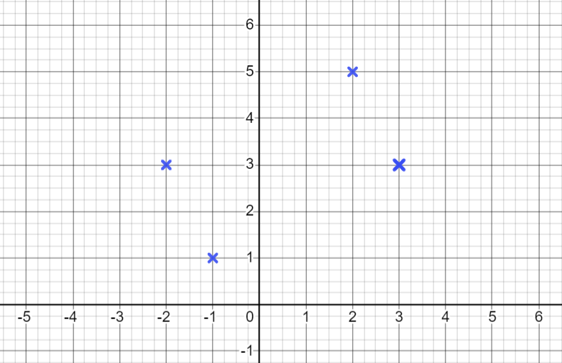
Creating shapes in Desmos
2) Plot each set of coordinates to determine the type of quadrilateral they make.
c) (0,9) (3,9) (0,6) (4,5)
a) (-12.5,-3) (-12.5, 1.5) (0,-3) (0,1.5)
Rectangle
Kite
b) (-8.2,-20) (1.4,-16.3) (-1.2,-16.3) (-5.6,-20)
d) (-2,3) (3,3) (2,5) (-1,1)
Parallelogram
Rectangle

Slide 43
Plotting coordinates generated from a rule using technology
Coordinates can be plotted into graphing software such as Desmos.
Rules can be entered into Desmos in the form of an equation and a line of infinite coordinates will be drawn.
Plotting coordinates using technology makes it easy to see coordinates that are not following the rule.
Desmos can be used to create mathematical shapes using coordinates.

Slide 44

© Oak National Academy 2023.
Produced in partnership with Mathematics in Education and Industry.
Licensed on the Open Government Licence v3.0, except where otherwise stated. See Oak terms and conditions.

